Slide 1
HANDWRITING
हस्तलेखन

Slide 2
Introduction
writing with the hand
The form of writing peculiar to each person.
Pressure on the penholder
Pressure of the pen point on the
varies continuously during writing, and the speed of writing is not uniform but depends upon the type of stroke being made

Slide 3
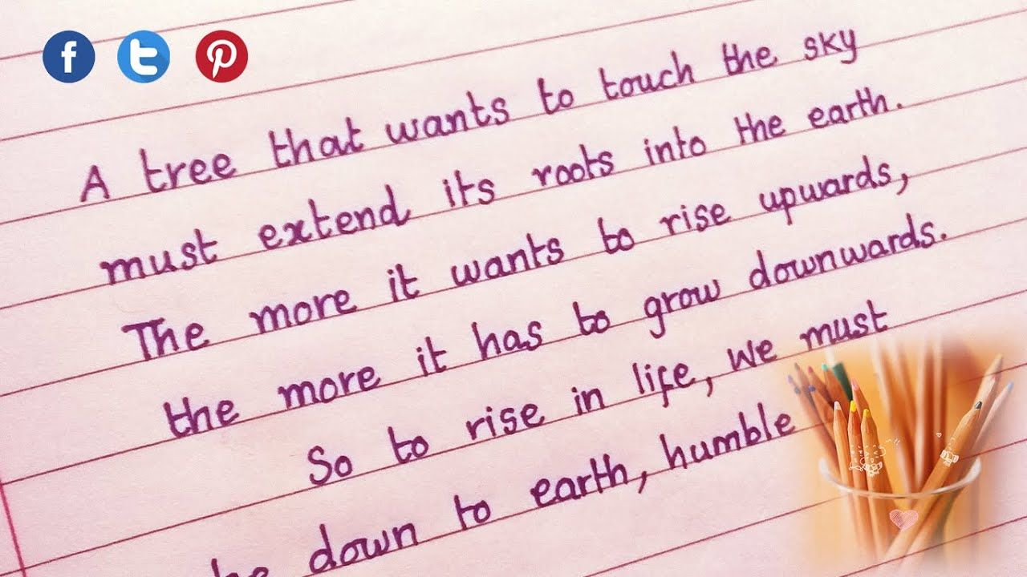

Slide 4
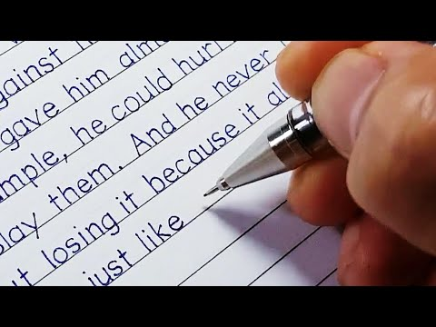

Slide 5
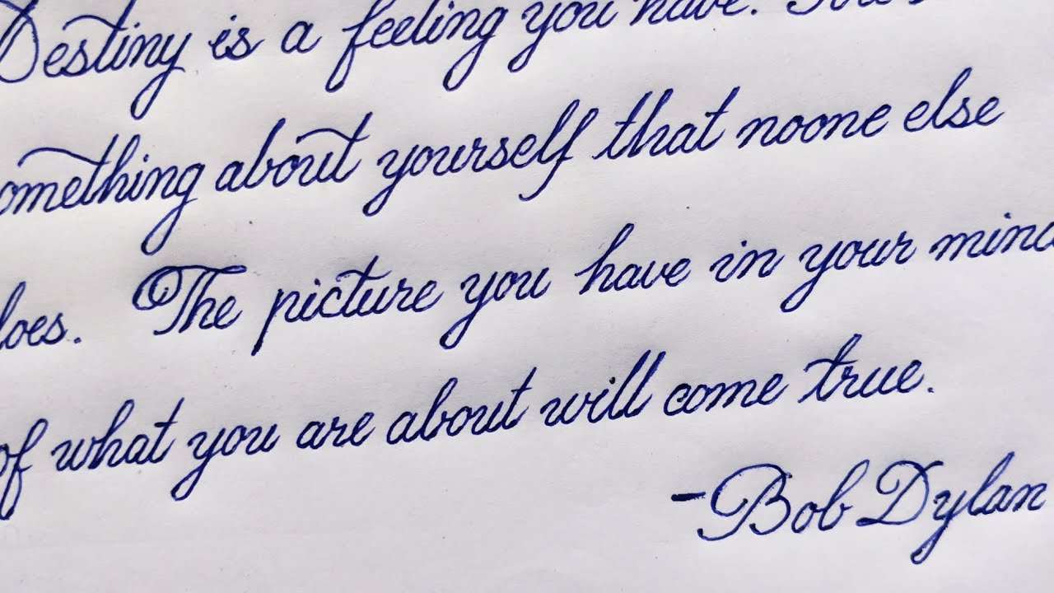

Slide 6
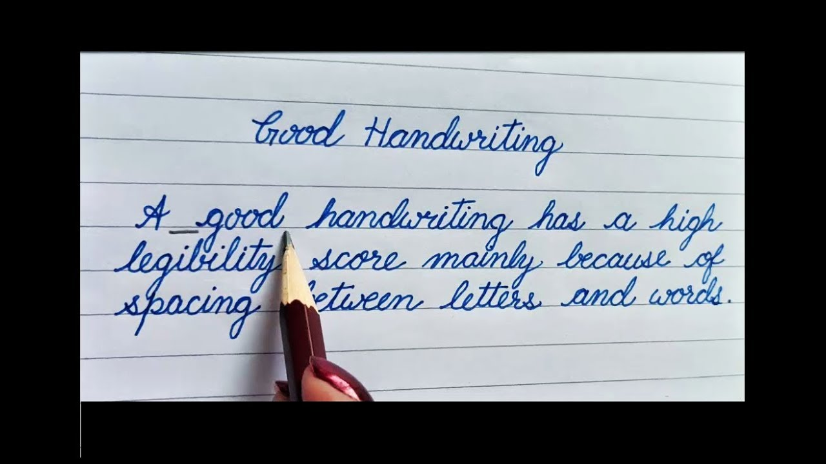

Slide 7
Teaching handwriting is one of the basic tasks of the elementary grades in all school systems.
The form of instruction differs according to the nature of language script, the system of instruction, and the availability of writing materials and instruments.

Slide 8
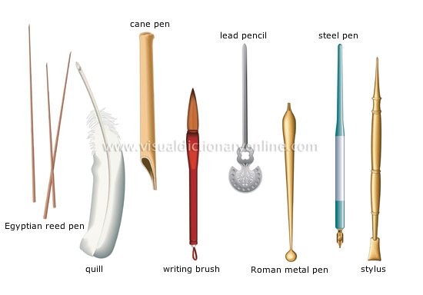

Slide 9
Teachers generally emphasize
correctness of letter formation
neatness of writing
uniformity of letters
spacing of letters and words
alignment of words and sentences
and speed of writing.

Slide 10
Size of the letter : The size of the letter should not be too big or too small to read, it should be average and clearly readable.
Pressure on the paper : This determines the pressure given by the writer while writing. Giving too much pressure leaves the impression of writing to 4-5 pages ahead, so the pressure given while writing should also be normal.

Slide 11
Connecting strokes : The strokes that connect a letter with another letter are known as connecting strokes, this shows whether the writer lifts the pen while going to another letter or connects the letters with each other. To develop good connecting strokes children are given pre writing practices on lines,shapes and strokes.
Beginning and ending strokes : This reflects whether the writer has an ending stroke or a beginning one, i.e. the writer has a flow towards the end or at the beginning.

Slide 12
Dots and cross- strokes : In some small letters like "i", "j" dots are used and for letters like "t", "f" cross strokes are applied. For any handwriting to be said as good these dots and cross-strokes also should be accurate.
Space between the words : Earlier we talked about spaces between the letters but a handwriting to be good and readable space kept between the words is very crucial. A good handwriting has a high legibility score mainly because of spacing between words.

Slide 13
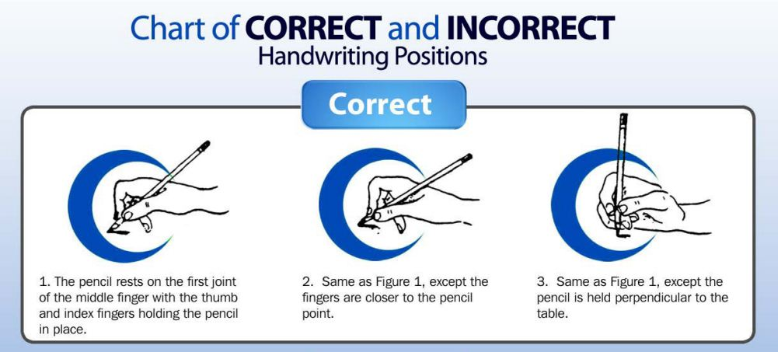

Slide 14
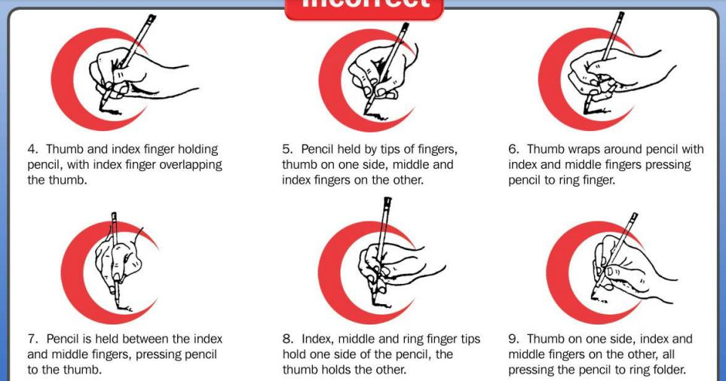

Slide 15
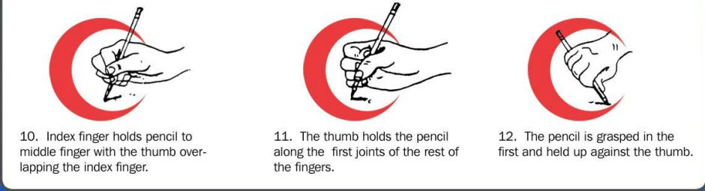

Slide 16
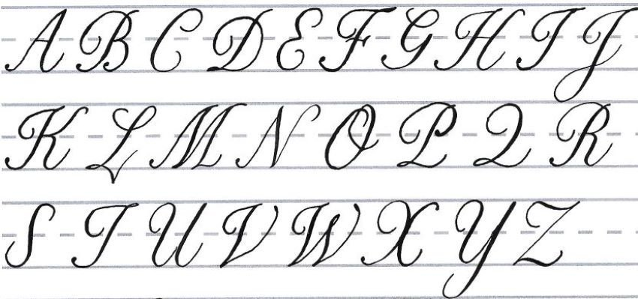

Slide 17
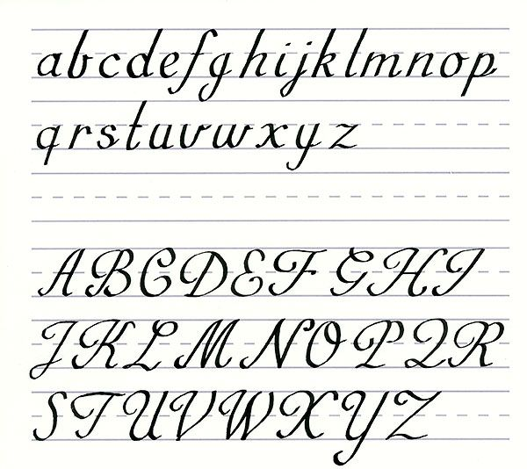

Slide 18
Print Handwriting

Slide 19
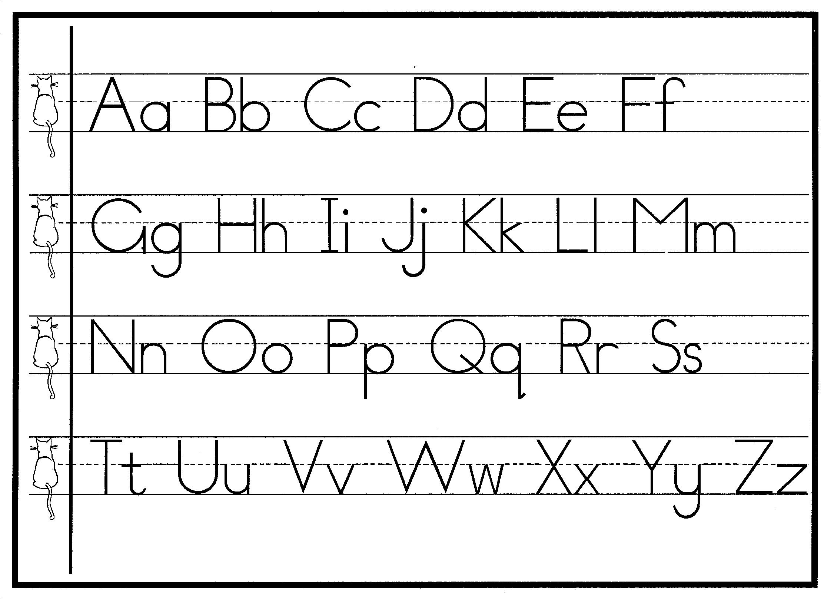

Slide 20
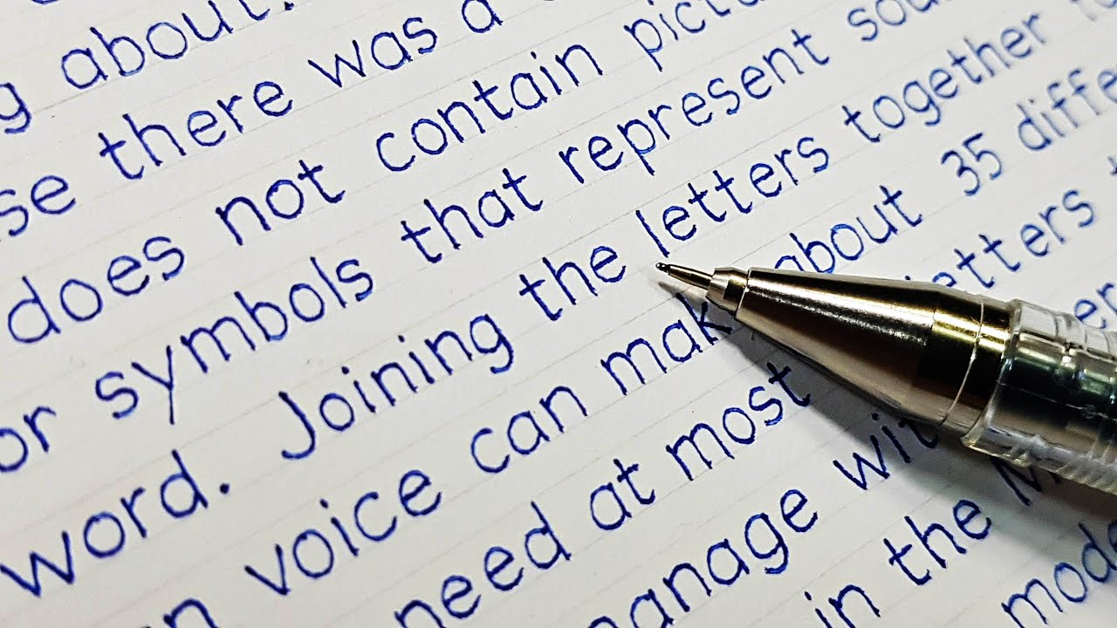

Slide 21
Modern Cursive

Slide 22
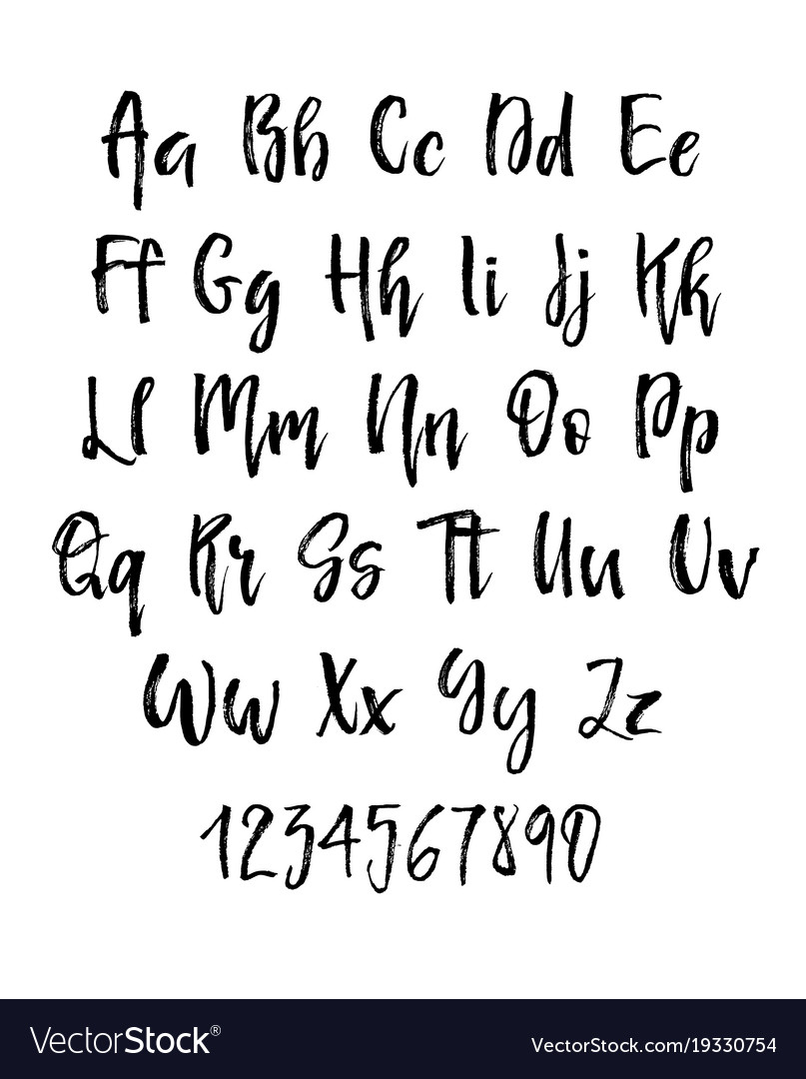

Slide 23
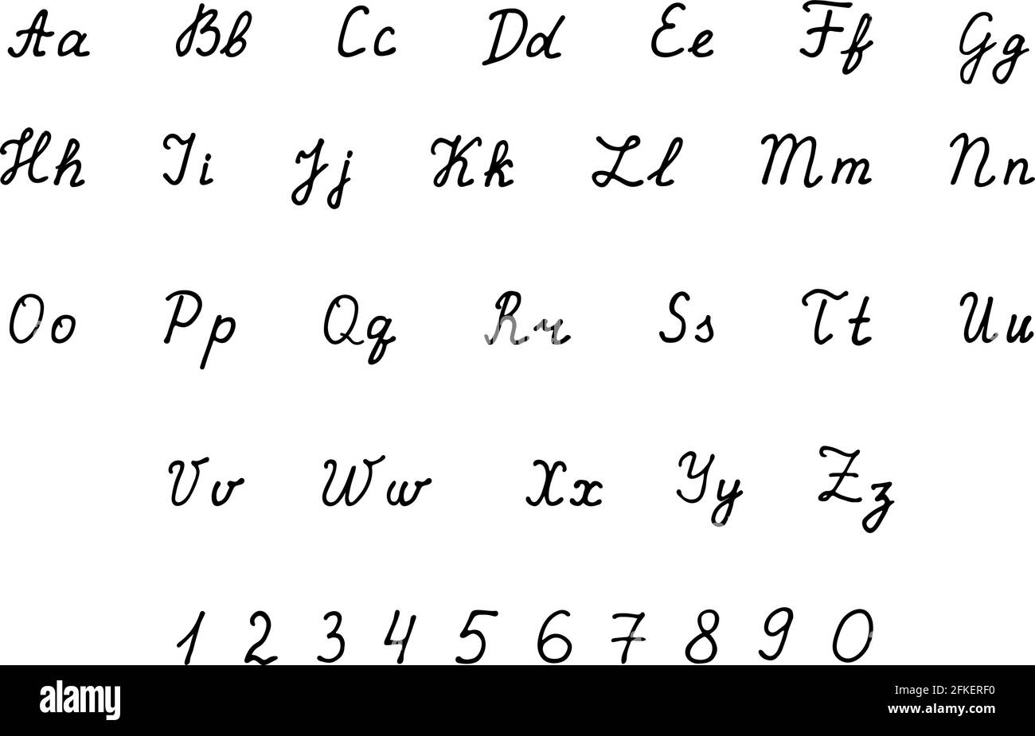

Slide 24
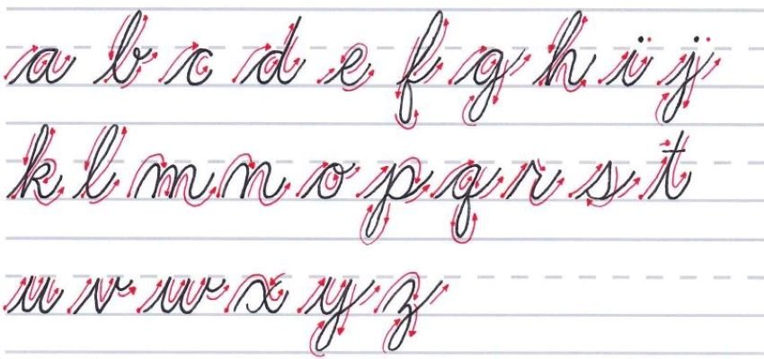

Slide 25
